Slide 1
Test Levels

Slide 2
Types of Testing
Unit Testing
Integration Testing
System Testing
Sanity Testing
Smoke Testing
Interface Testing
Regression Testing
Beta/Acceptance or Alpha Testing

Slide 3
Unit Testing
It focuses on smallest unit of software design. In this we test an individual unit or group of inter related units. It is often done by programmer by using sample input and observing its corresponding outputs.
Example:
a) In a program we are checking if loop, method or
function is working fine
b) Misunderstood or incorrect, arithmetic precedence.
c) Incorrect initialization

Slide 4
Component Testing
In Component testing, all the modules/ components of the related software are checked individually with or without segregation with other objects or modules of the system.
In Component Testing, testing is performed by validating use cases and test requirements, while in Unit Testing, we will test the application in contradiction of the design documents.
Component Testingis executed at the application level; on the other hand; Unit Testing is executed at a granular level.
Component Testingis a type of black-box testing, whereas Unit Testing is part of the white box testing.

Slide 5
Black Box testing:- It is used for validation.
In this we ignores internal working mechanism and
focuses on what is the output?
White Box testing:- It is used for verification.
In this we focus on internal mechanism i.e.
how the output is achieved?
Grey Box Testing:- In Software Engineering, Gray Box Testing gives the ability to test both sides of an application, presentation layer as well as the code part.

Slide 6
Integration Testing
Testing of all integrated modules to verify the combined functionality after integration is termed as Integration Testing.
Modules are typically code modules, individual applications, client and server applications on a network, etc. This type of testing is especially relevant to client/server and distributed systems.
Integration Test aims to test how well several units interact with each other.

Slide 7
System Testing
Under System Testing technique, the entire system is tested as per the requirements. It is a Black-box type Testing that is based on the overall requirement specifications and covers all the combined parts of the system
In this we just focus on required input and output without focusing on internal working.

Slide 8
Acceptance Testing
Mostly Carried Out By End User/ Customer
Goal of acceptance testing is to establish confidence in the
system, part of the system or specific non-functional
characteristics, e.g. usability, of the system
Most often focused on a validation type of testing.
Focus is trying to determine whether the system is
“Fit for Purpose”
Final sign-off provided as a proof of acceptance of the system
Notes:
Acceptance testing may occur at more than just a single level, for example:
• A Commercial Off The Shelf (COTS) software product may be acceptance tested when it is installed or integrated.
• Acceptance testing of the usability of a component may be done during component testing.
Acceptance testing of a new functional enhancement may come before system testing.

Slide 9
Component testing: searches for defects in and verifies the functioning of software components (e.g. modules, programs, objects, classes etc.) that are separately testable;
Integration testing: tests interfaces between components, interactions to dif ferent parts of a system such as an operating system, file system and hard ware or interfaces between systems;
System testing: concerned with the behavior of the whole system/product as defined by the scope of a development project or product. The main focus of system testing is verification against specified requirements;
Acceptance testing: validation testing with respect to user needs, require ments, and business processes conducted to determine whether or not to accept the system.

Slide 10
Regression & Progression Testing
Testing an application for the modification in any module or functionality is termed as Regression Testing. It is difficult to cover all the system in Regression Testing, so typically Automation Testing Tools are used for these types of testing.
Progression testing focusses on new functionality and proving that it works as per the requirements. Whereas regression testing focuses on proving that existing functions of the application are not broken from the addition of new code.
Ultimately, with regression testing, we are making sure that we have not broken anything when we introduce new code.

Slide 11
Smoke Testing
Whenever a new build is provided by the development team then the Software Testing team validates the build and ensures that no major issue exists.
The testing team ensures that the build is stable and a detailed level of testing is carried out further. Smoke Testing checks that no show stopper defect exists in the build which will prevent the testing team to test the application in detail.
If testers find that the major critical functionality is broken down at the initial stage itself then testing team can reject the build and inform accordingly to the development team. Smoke Testing is carried out to a detailed level of any Functional or Regression Testing.

Slide 12
Sanity Testing
Sanity Testing is done to determine if a new software version is performing well enough to accept it for a major testing effort or not. If an application is crashing for the initial use then the system is not stable enough for further testing. Hence a build or an application is assigned to fix it.

Slide 13
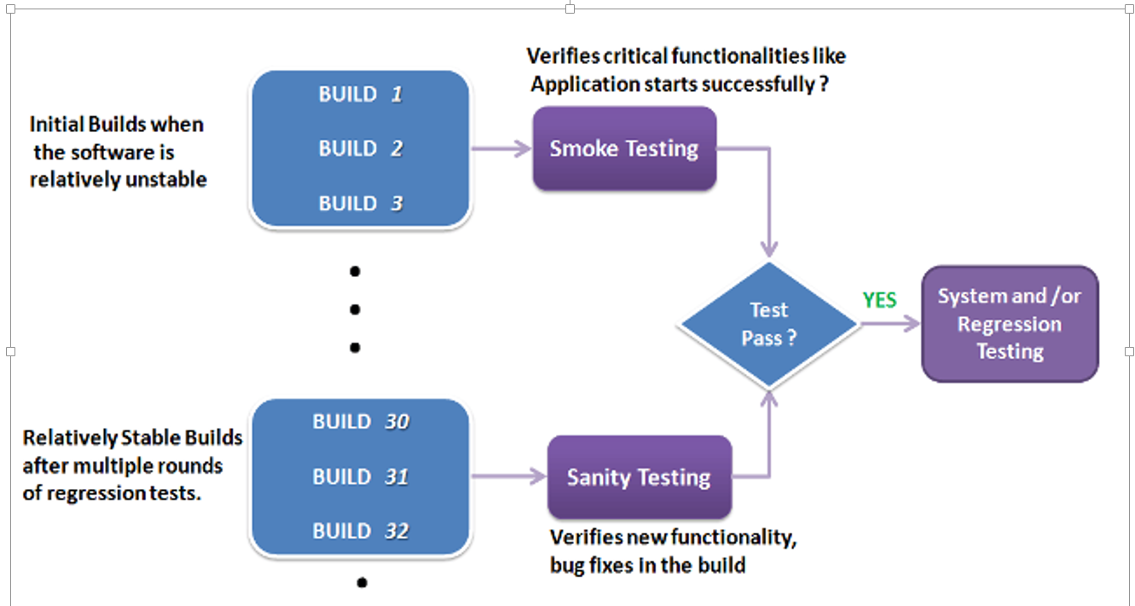

Slide 14
Smoke vs Sanity Testing
Smoke testing means to verify (basic) that the implementations done in a build are working fine.
Sanity testing means to verify the newly added functionalities, bugs etc. are working fine

Slide 15
Alpha Testing
This is a type of validation testing. It is a type of acceptance testing which is done before the product is released to customers. It is typically done by QA people.
Example:
When software testing is performed internally within the organization.

Slide 16
Beta Testing
The beta test is conducted at one or more customer sites by the end-user of the software. This version is released for the limited number of users for testing in real time environment
Example:
When software testing is performed for the limited
number of people

Slide 17
Stress Testing
In this we gives unfavorable conditions to the system and check how they perform in those condition.
Example:
(a) Test cases that require maximum memory or other
resources are executed
(b) Test cases that may cause thrashing in a virtual
operating system
(c) Test cases that may cause excessive disk requirement

Slide 18
Performance Testing
It is designed to test the run-time performance of software within the context of an integrated system.It is used to test speed and effectiveness of program.
Example:
Checking number of processor cycles.

Slide 19
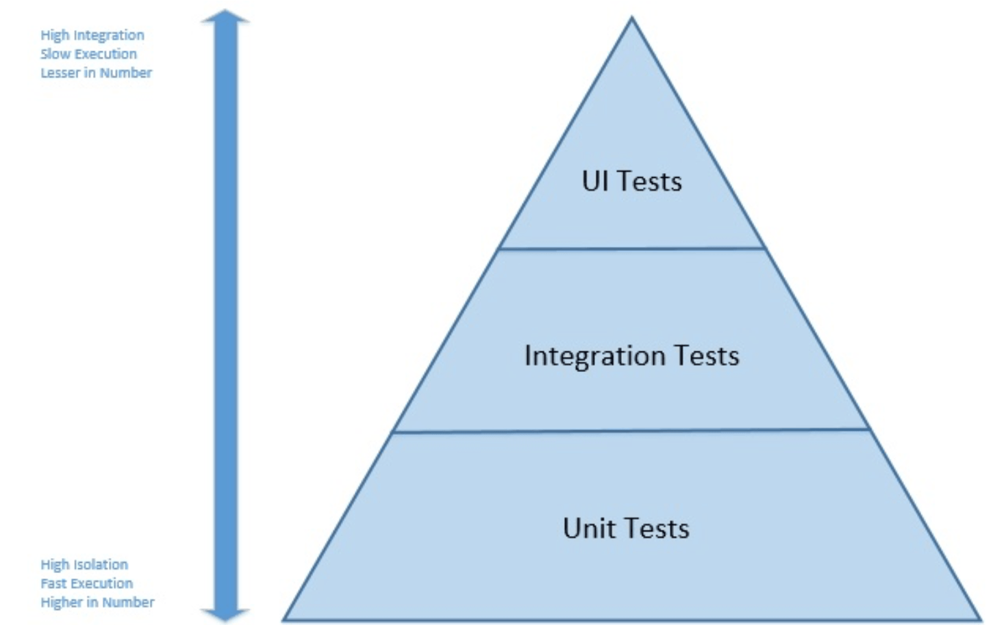
Test Pyramid

Slide 20
Characteristics of a good unit test
Fast. It is not uncommon for mature projects to have thousands of unit tests. Unit tests should take very little time to run. Milliseconds.
Isolated. Unit tests are standalone, can be run in isolation, and have no dependencies on any outside factors such as a file system or database.
Repeatable. Running a unit test should be consistent with its results, that is, it always returns the same result if you do not change anything in between runs.
Self-Checking. The test should be able to automatically detect if it passed or failed without any human interaction.
Timely. A unit test should not take a disproportionately long time to write compared to the code being tested. If you find testing the code taking a large amount of time compared to writing the code, consider a design that is more testable.

Slide 21
Some examples are:
Regression test after debugging or further development of software
Testing of software on different platforms or with different configurations
Data-driven testing (creation of tests using the same actions but with many different inputs)
Test automation allows performing different types of testing efficiently and effectively.

Slide 22
When & Why
Tests can run fast and frequently
Cost-effective for software products with a long maintenance life
Useful in agile environment
Robust test automation projects balanced for value and effort
optimization of Efficiency & Quality
Quick return on investment(ROI) of test automation
Advanced a tester’s motivation and efficiency
More efficient assignments of QA Tasks
Increase of Test Coverage
Different types of testing to increase test coverage

